Slide 1
Expense Manager
#ID: 16201064
16201058

Slide 2
Description:
Daily Expense Manager is a simple but powerful PHP script to manage our expenses .
Expense manager designed to help individual or business budget, track and possibly control our expenses.
It supports tracking of both our expenses and income.
This expense management system provides an integrated set of features to help us to manage our expenses and cash flow.
It provides the ability to group our income/expenses into categories and let us set a budget and track expenses in the category.

Slide 3





Technologies:
Front End:
Back End:
Back End:
Database: mysql

Slide 4

Technologies:
PHP Development tool: Visual Studio code
Visual Studio Code combines the simplicity of a source code editor with powerful developer tooling, like IntelliSense code completion and debugging.

Slide 5

Technologies:
Framework: Laravel
Laravel is a relatively new PHP framework but the most popular PHP Framework
It has many features that make rapid application development possible.
It provides a number of helpful commands while developing the application
It has a powerful tinplating engine

Slide 6
Features:
Stores Daily Expenses Detail
Stores Daily/Monthly Earnings
CRUDs for income and expenses
Calculate Remaining Balance
Shown Monthly expenses Report
Search option to display specific item's expenses
Formatting currency

Slide 7
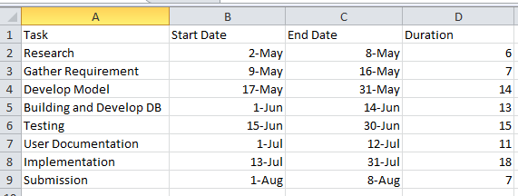
Gantt chart:

Slide 8
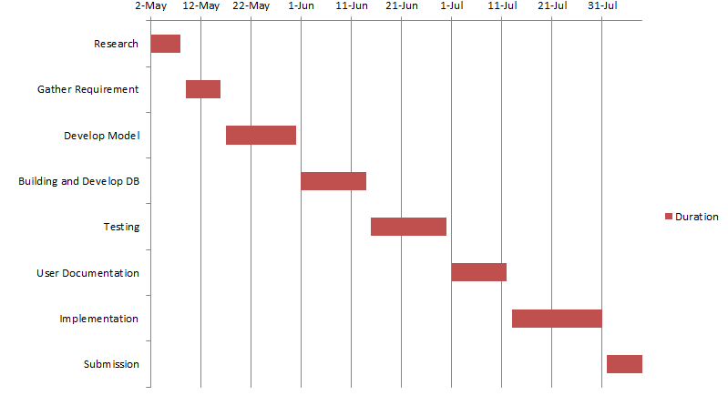
Gantt Chart:

Slide 9
Thank You

